Slide 1
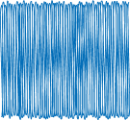




ject
Fi
nal
Pro
Ce Lan
Jin Yang

Slide 2
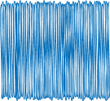
Steps
1
Import Data and Get Images
2
Prepare X and y
3
Build and Train Model
4
Get Result and Save

Slide 3
1
Import Data and Get Images

Slide 4
Import Data

Slide 5
Unzip File

Slide 6
Rename Images

Slide 7
2
Prepare X and y

Slide 8
Preparing X and y

Slide 9
Preparing X and y

Slide 10
Preparing X and y

Slide 11
3
Build and Train Model

Slide 12
Build Model

Slide 13
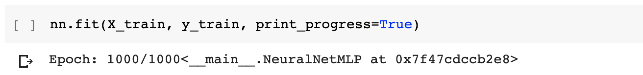
Train Model

Slide 14
4
Get Result

Slide 15
Get X_test

Slide 16
Get Result

Slide 17
Save csv file

Slide 18
THANK
S

